Slide 1

Management of Organizational Data
Final Project Presentation

Slide 2





Meet the Team
Supriya Malla
Sesha Sreeja Sadhu
Sanchit Agarwal
Jai Trivedi
Alex Baker
Section 1 Group 5

Slide 3
AGENDA
01
02
03
Company Overview
Objective
Process Flow
04
05
06
Entity Relationship Diagram
Insights From Queries
Relationship
Schema

Slide 4
About Sudha Gold Covering Industry
Sudha Gold Industries is an imitation jewelry manufacturer based in India.
It sells its jewelry in India through one-on-one sales as well as retail.
The company began with less than 20 employees in 1975 and has grown to a modest 500-member workforce.

Slide 5
Our Objective: Organizing the Database
The company is currently running unorganized in its database management, collecting data with a MS Access .mdb file to catalog for reference.

Slide 6
THEIR PROBLEM
OUR SOLUTION
The client conveyed a need to clean the data and extract tables needed to build a database for an executive overview.
Currently, the client has several unconnected but interdependent databases, attempting to create an efficient model that is effective and compatible with all required entities.
Cleaning and normalising the Microsoft Access .mdb database file management system.
Creating a master database for entities such as Sales, Orders, Salesmen, Invoice and Catalogue
Querying the database in SQL to get executive overview results on demand and performance.

Slide 7
We divided the problem into 4 steps
Create ERD
Migrate to SQL
Make Relational Schema
Perform Queries
2
1
3
4
To visualize the database
Leveraging our database
Explain entities relations
Analyze the data in SQL

Slide 8
01
ERD Diagram

Slide 9
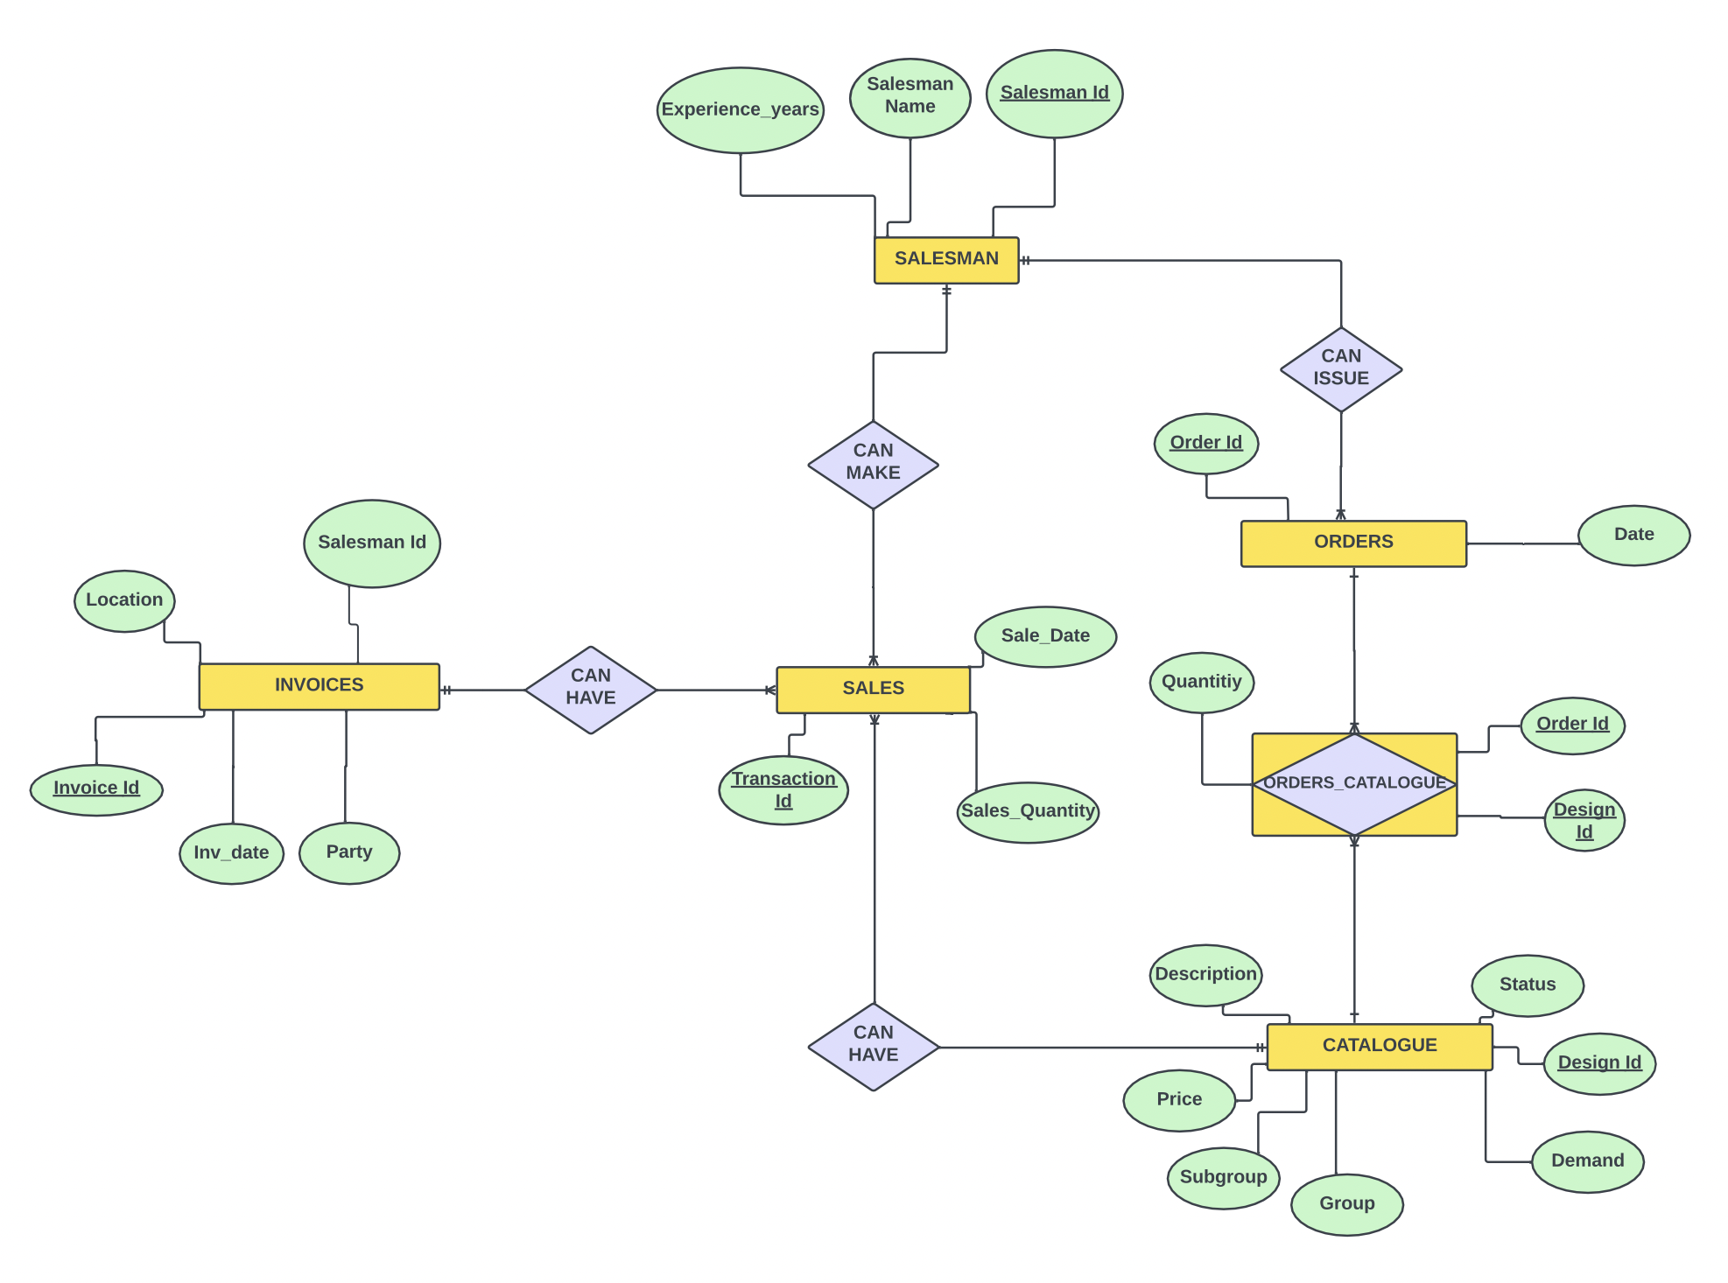

Slide 10
Tables given
Entities Created
Catalogue
Order details
Salesman details
Sales details
Ship Invoices
Catalogue
Orders
Order-Catalogue
Salesman
Sales
Invoice

Slide 11
02
Relationship Schema

Slide 12
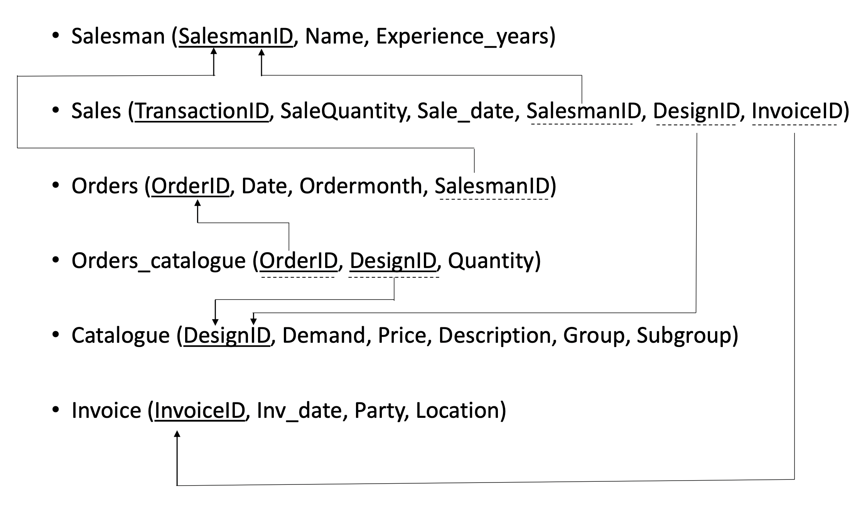
Relationship Schema

Slide 13
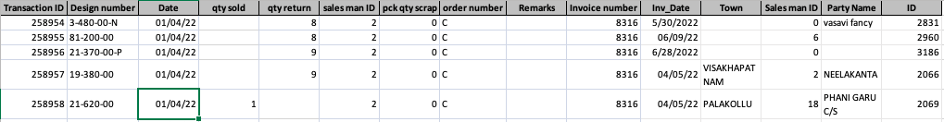
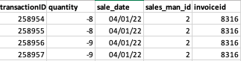
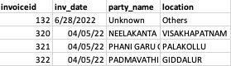
Normalization Process
SALES DETAILS
1NF
2NF
SALES
INVOICES

Slide 14
03
Migrating to SQL

Slide 15
STEP 1
Since the client had no relationship between tables they used redundant columns in tables.
We dropped the columns and that are not required in the database.
Few of the rows had repetitive values for the primary keys of the table we combined the rows on different formulas using excel.
Cleaning The Data

Slide 16
STEP 2
Then created a schema and added our cleaned tables.
Defined the relationships based off the Relational Schema.
Defined the primary keys and identified relationships.
Creating The Database

Slide 17
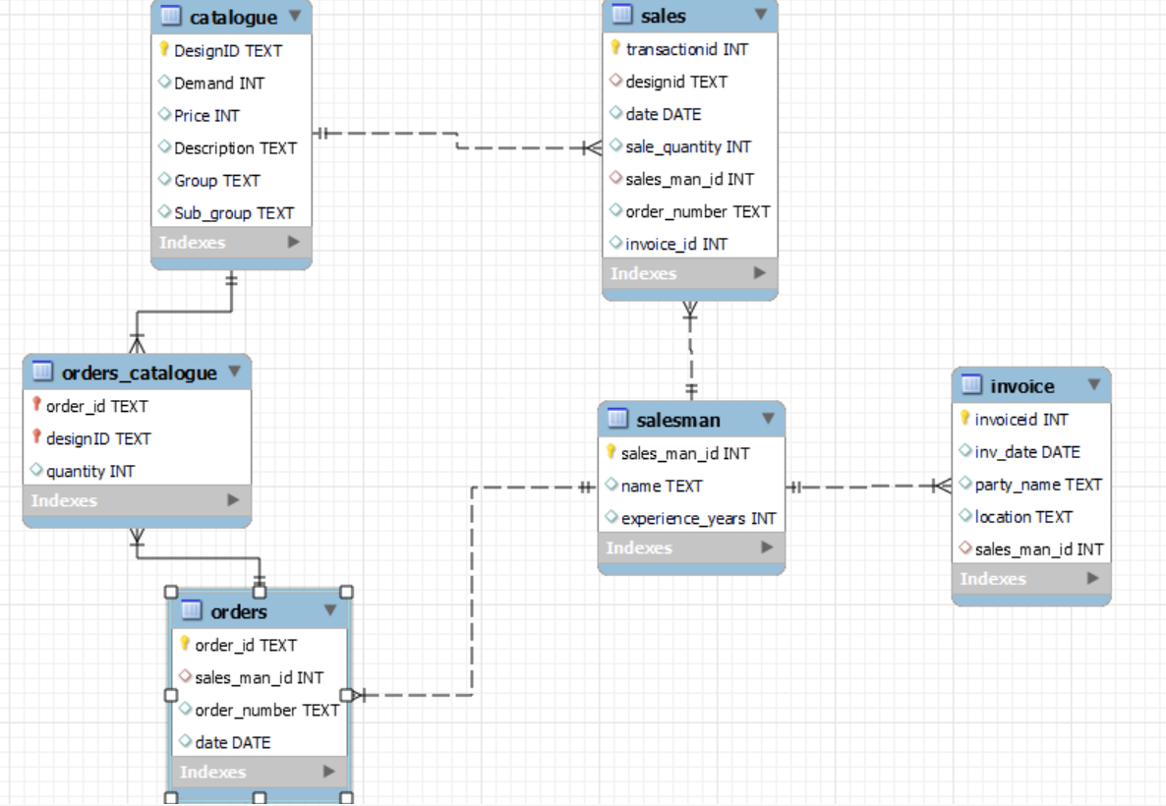
DATABASE SCHEMA

Slide 18
04
Business insights

Slide 19
Revenue Analysis

Slide 20
Best selling designs
Chains as a segment bring in the highest order volume
The main focus for the firm should now be to capture the market beyond sales which they have not focussed on so far

Slide 21
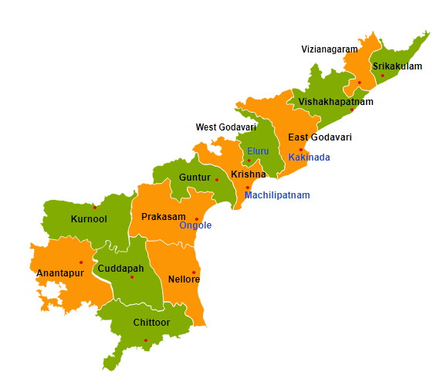
Revenue by Location Target The Western Front Of Andhra Pradesh As It Generates Highest Revenue ~₹12.5 Mill
A lot of revenue comes form the western part of Andhra Pradesh
Revenue generating locations can have satellite offices set up to ensure higher in person sales calls

Slide 22
Top Buyers Establish Relations with Top Buyers for Steady Cash Flow
Observations:
Top buyers can be targeted for long term contracts as they are the buyers accounting for highest revenues
Ensuring a long term relationship with them will help the company establish a steady cash flow

Slide 23
Seasonality

Slide 24
Weekly Revenue Majority Sales Occur During The Initial Half Of Every Month
Observations:
Average Sales Value across the quarter is ~₹3.325 Million
We see that the beginning of every month foresees a spike in the orders
Week 3 onwards the dip can help restock fast moving items for the next months sales

Slide 25
Orders Returned Studs are the most frequently returned product in the catalogue
The total orders show a healthy uptick in the initial weeks similar to what is also reported by the sales trend
The last week has the highest return percentage which might be due to buyers returning defective products bought earlier as well

Slide 26
Salesmen Performance

Slide 27
Revenue by Salesmen Top 5 Salesmen Bring In ₹25m+ In Revenue
Observations:
Ashok, Anji are top performing salesmen with their total revenue being more than ₹12M
Their expertise can be leveraged by Sudha industries to train other employees
They can be incentivized to train more employees and have a more control in onboarding new employees

Slide 28
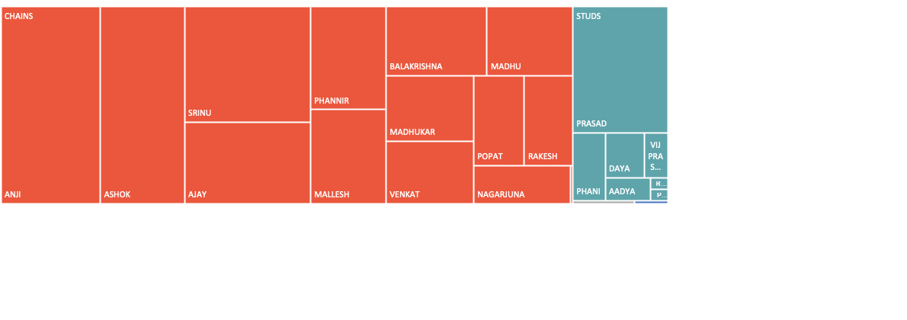
Top Product sold by Salesmen With Chains In High Demand, ~15 Salesmen Are Selling Chains Only
Anji and Ashok’s expertise in selling Chains could be leveraged by Sudha Industries to re-focus on other product categories like bangles, studs, etc.

Slide 29
Inventory Management

Slide 30
Forecasting Accuracy Only ~1% Of The Demand Is Accurately Measured
Observations:
Forecasting for the inventory should be estimated using other techniques such as regression analysis
Imitation jewelry is a fast-moving business that requires lower stockouts and stock-ins to plan for upcoming events like marriages and festivals.
This can also help them refine product quality but not producing in excess and updating the designs well in advance.

Slide 31
Price Sensitivity Average Order Volume When Plotted With Different Prices Could Give Us An Optimal Pricing
Optimal Price should be between ₹110 – ₹160
Optimal Price should be between ₹120 – ₹140
Optimal Price should be between ₹22 – ₹38
Optimal Price should be between ₹105 – ₹160

Slide 32
Our Client’s Info:
Sudha Gold Covering Industries
12/39, Srinivas Nagar Colony, Rustumbada, Machilipatnam, Andhra Pradesh 521001, India
Phone Number: +91 93939 21220
https://sudha-gold-covering-industries.business.site/

Slide 33
THANK YOU!

